Slide 1
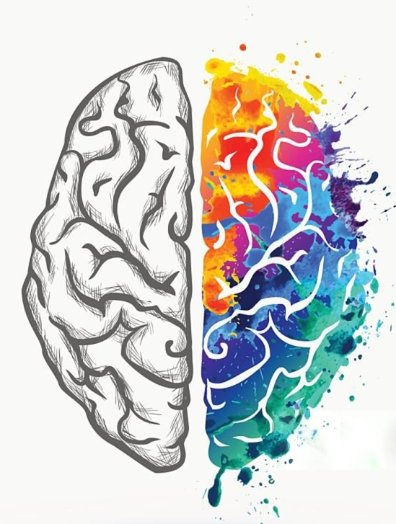
Emotion
Chad Williams
University of Victoria

Slide 2
Lecture Outline
Emotions
The Limbic System
Regions Beyond the Limbic
Stress

Slide 3
Lecture Outline
Emotions
The Limbic System
Regions Beyond the Limbic
Stress

Slide 4
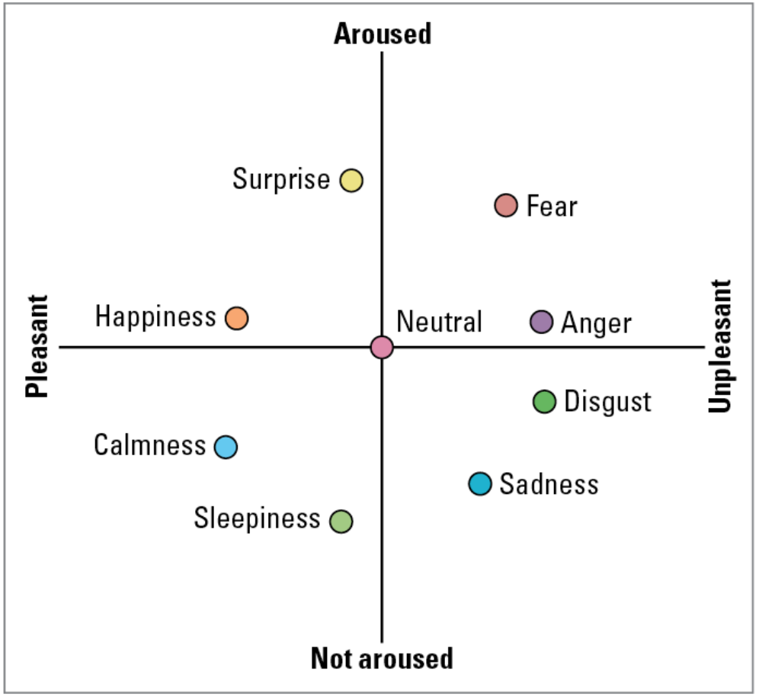
Emotions
Emotion: A mostly automatic internal state with a physiological response to an object or situation
Emotions lie on two dimensions
Arousing versus not arousing
Pleasant versus unpleasant

Slide 5
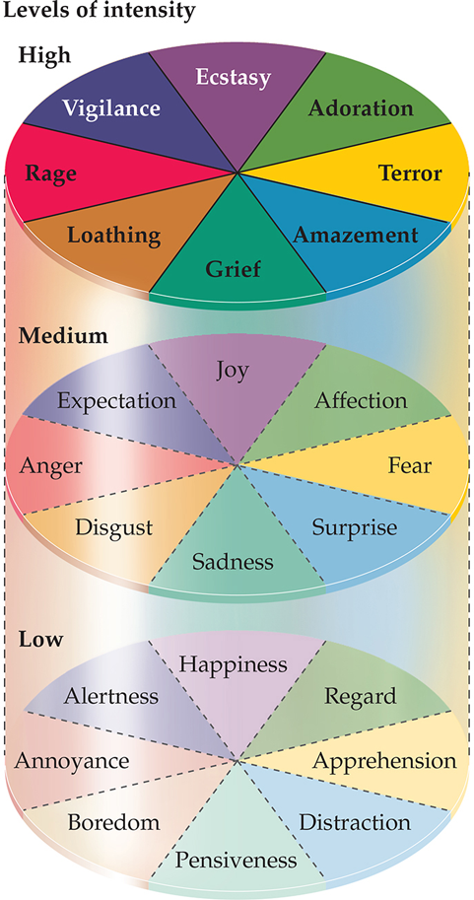
Emotions
Plutchik’s Wheel of Emotions
Joy vs Sadness
Affection vs Disgust
Anger vs Fear
Expectation vs Surprise
Features
Emotions have intensity
Other emotions are thought to be the combination of these core emotions
Expressed behaviourally, especially through facial expressions

Slide 6

Emotions
Emotions: Feelings reflect an internal state
Expressed as behaviours
Hugging, lashing out
Affected by cognition
Memory, attention
Causes physiological changes
Heart rate, sweat

Slide 7
Emotions
Two-Factor Theory of Emotion
Emotions are caused by the combination of
physiological arousal
cognitive interpretation of the environment

Slide 8
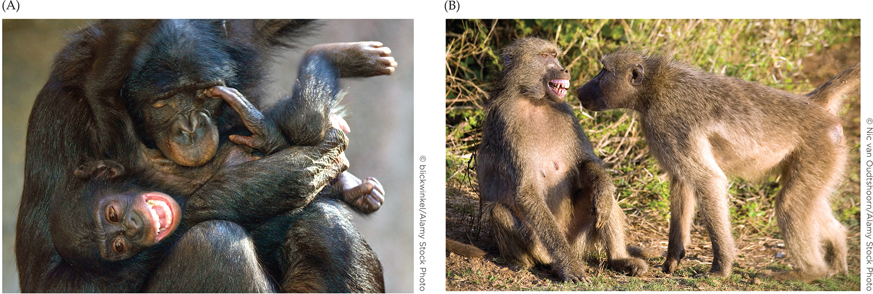
Emotions
Emotions Across Species
Core emotions have been observed in species beyond humans
Primates present facial expressions of grimace, tense mouth, and play face
Rats make ultrasonic noise akin to laughter
Rats also show facial expressions

Slide 9
Emotions
Emotions Across Species
Hypothesized as a form of quick communication
Facilitates cooperations and mating
Warns of predators
Informs about food sources
Disgust of food warns of toxicity
Humans are quick to judge based on facial expressions
Face is highly visible and processed rapidly

Slide 10
Lecture Outline
Emotions
The Limbic System
Regions Beyond the Limbic
Stress

Slide 11
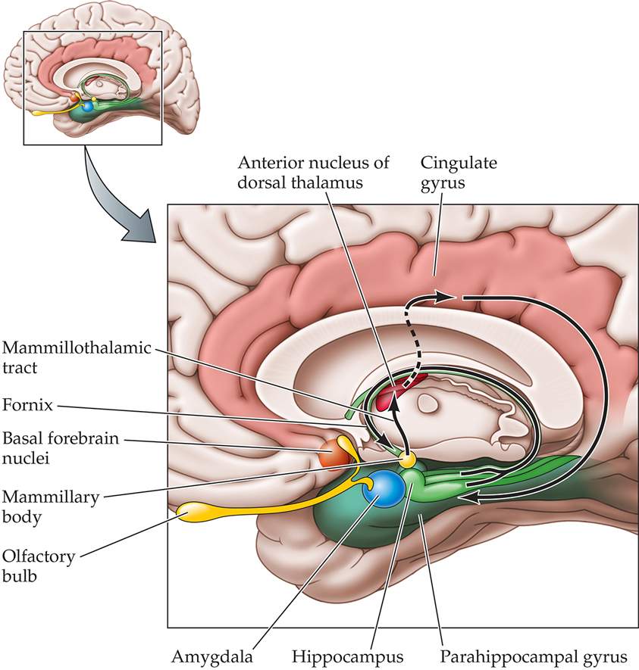
The Limbic System
The Limbic System
Hypothalamus: Autonomic and endocrine responses to emotion
controls heart rate, arousal, and stress hormones
Thalamus: Relay between subcortical and cortical emotion areas;
Links memory and emotion
Cingulate Cortex: Integrates emotional experience with attention and decision-making
Connects emotional states to purposeful behavior

Slide 12
The Limbic System
The Limbic System
Hippocampus: Memory formation and context
Gives emotional experiences a temporal and spatial background (where and when it happened)
Fornix: Fiber tract connecting the hippocampus to the hypothalamus (especially the mammillary bodies)
Carries signals within the limbic circuit

Slide 13
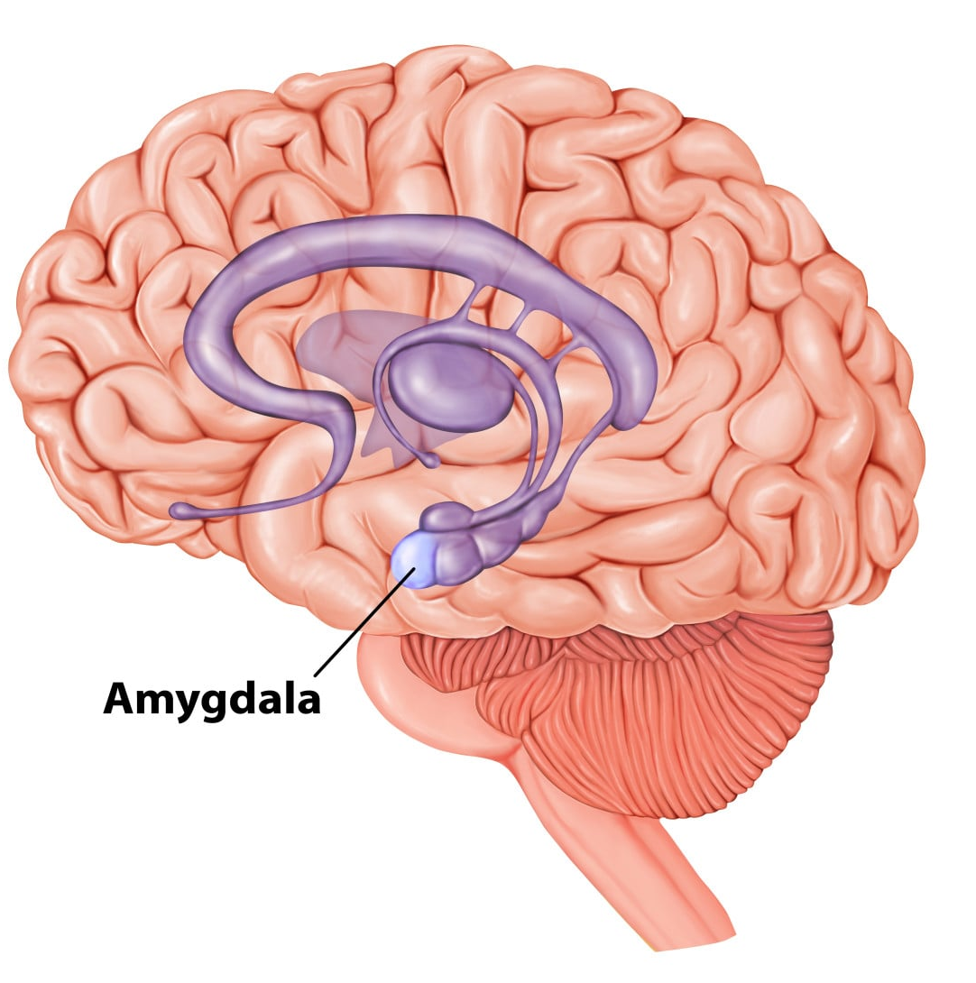
The Limbic System
The Limbic System
Amygdala: Detects emotionally salient stimuli
Intense threatening or rewarding stimuli
Coordinates behavioral, autonomic, and hormonal emotional responses
Links sensory input to arousal states
Associates emotions to memories

Slide 14
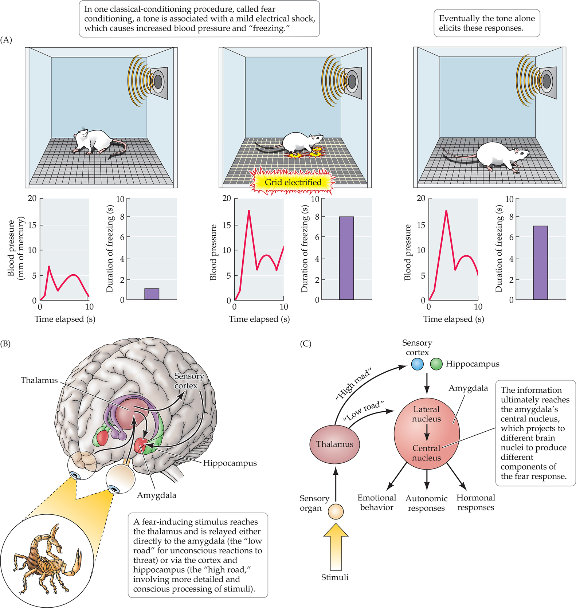
The Limbic System
Nuclei of the Amygdala
Lateral Nucleus
Primary input (first region activated)
Associates stimuli with aversive events
Receives bottom-up and top-down information
Central Nucleus
Primary output (last region activated)
Coordinates three responses
Emotional behaviours (e.g., freezing)
Fast, immediate responses
Autonomic responses (e.g., increase heart rate)
Fast, immediate responses
Hormonal responses (e.g., release cortisol)
Slow, long-term response

Slide 15
The Limbic System
Pathways to the Amygdala
Low Road:
Thalamus -> Amygdala
Bottom-up processing of emotions
Immediate emotional reactions
Fight-or-flight
High Road:
Cortex & Hippocampus -> Amygdala
Top-down processing of emotions
Detailed, memory-informed, conscious processing

Slide 16
The Limbic System
LeDoux, 1994
Research Question: Is the amygdala involved in producing a fear response?
Methods:
Fear-conditioning associated a tone with an electrical shock in rats
Lesioned amygdala to see if fear response persisted

Slide 17
The Limbic System
LeDoux, 1994
Independent Variable: Pre and post lesioning the amygdala
Dependent Variable: Blood pressure and freezing duration

Slide 18
The Limbic System
LeDoux, 1994
Results:
Fear responses to the tone

Slide 19
The Limbic System
LeDoux, 1994
Results:
Fear responses to the tone
Lesioning the amygdala removed this fear response to the tone

Slide 20
Before
Fear-Conditioning
Fear-Conditioning
After
Fear-Conditioning
After
Amygdala Lesioning

Slide 21
The Limbic System
LeDoux, 1994
Conclusion: Amygdala is a necessary component for associated fear responses
Other research has shows that amygdala lesioning prior to conditioning also prevents the formation of new fear associations

Slide 22
Lecture Outline
Emotions
The Limbic System
Regions Beyond the Limbic
Stress

Slide 23
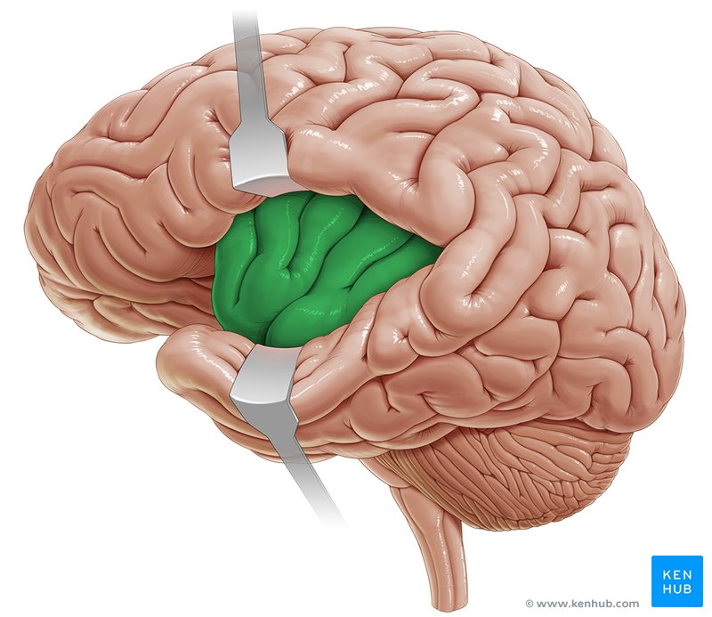
Regions Beyond the Limbic
Insula
Monitors internal bodily states (interoception)
Generates the subjective feeling component of emotion
Integrates physical sensations with emotional awareness
Especially associated with disgust
Insula

Slide 24
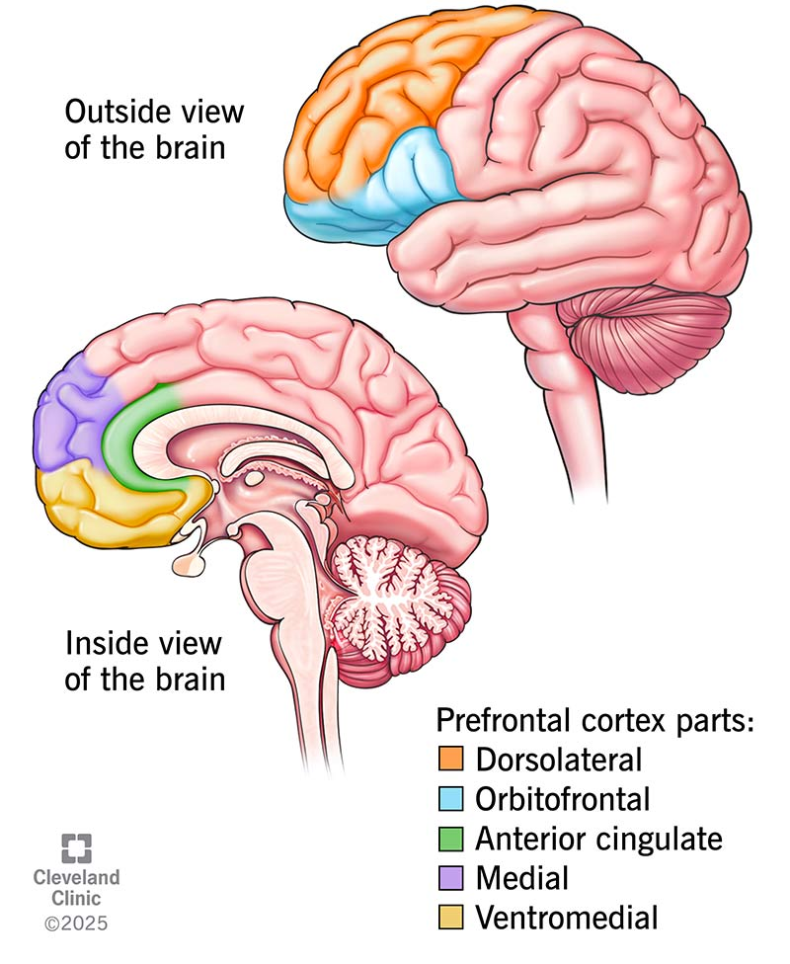
Regions Beyond the Limbic
Anterior Cingulate Cortex (ACC)
Integrates emotion, attention, and motivation
Detects emotional conflict and regulates behavior
Connects emotional experience to action
Strongly active in social and moral emotions

Slide 25
Regions Beyond the Limbic
Prefrontal Cortex (PFC)
Evaluates emotional meaning and context (appraisal)
Regulates or suppresses inappropriate emotional reactions
Supports decision-making influenced by emotion

Slide 26
Regions Beyond the Limbic
Prefrontal Cortex (PFC)
Orbitofrontal cortex (OFC): Evaluates reward and punishment value of stimuli
Especially associated with regret and reward
Ventromedial PFC (vmPFC): Involved in self-referential processing
Self-reflection: Understanding own emotions
Empathy: Understanding emotions of others

Slide 27
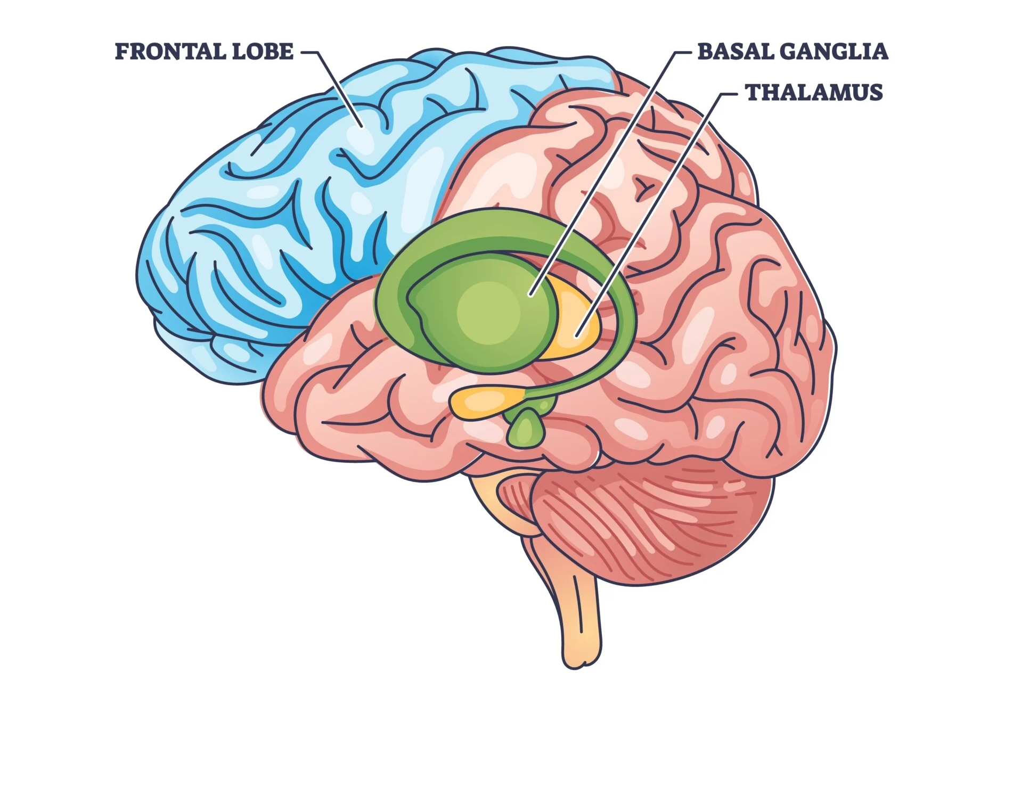
Regions Beyond the Limbic
Basal Ganglia
Processes reward, motivation, and goal-directed emotion
Reinforces pleasurable or socially rewarding experiences
Supports reward-based learning of emotional behavior

Slide 28
Lecture Outline
Emotions
The Limbic System
Regions Beyond the Limbic
Stress

Slide 29
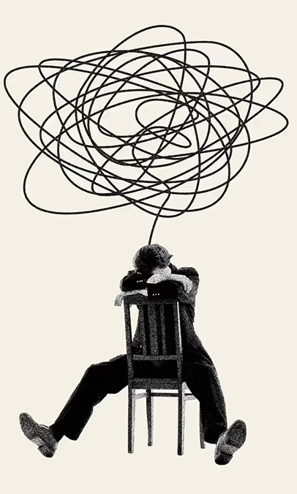
Stress
Stress: A physiological and psychological state of tension in response to demands or threats
Initiated by stressful stimuli or events
Activates stress-processing system
Results in an acute stress response
Allostasis: Physiological regulation in response to a stressor
Involves physiological adjustments to maintain internal balance
Has a cost: energy expenditure, tissue damage, vulnerability to illness and disease

Slide 30
Stress
Stress
Medical Consequences of Childhood Stress
More responsive adrenal system (stress-response)
Increased asthma symptoms
Impaired expression of anti-inflammatory genes
Enduring Effects of Childhood Stress
Impaired neural development
Especially in PFC, hippocampus, and amygdala
Impaired cognitive development
Attention, memory, executive functioning
Impaired emotional regulation
Impaired measures of lifetime achievement

Slide 31
Stress
Stress-Related Risk Factors
Psychological
Depression
Anxiety
Social
Social isolation
Conflictual relationships
Lack of support
Lifestyle
Poor sleep
Physical inactivity
Poor nutrition
Environmental
High-stress job
Financial insecurity
Chronic illness

Slide 32
Stress
Stress-Related Protective Factors
Psychological
Resilience and coping skills
Sense of purpose
Optimism
Social
Strong social support networks
Meaningful relationships
Community connection
Lifestyle
Regular physical exercise
Quality Sleep
Healthy nutrition
Environmental
Job satisfaction
Financial stability

Slide 33
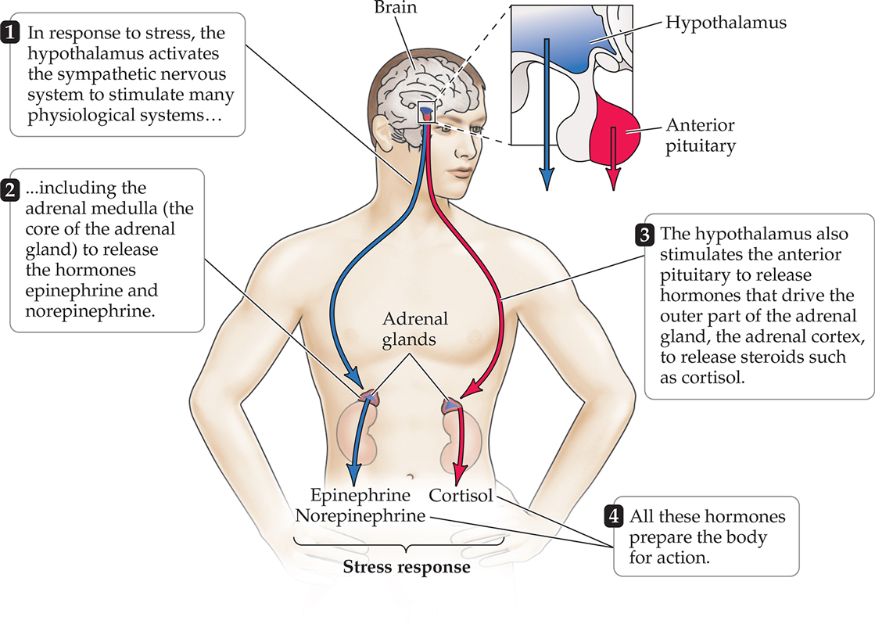
Stress
The Stress Response
Adrenal Medulla: Releases hormones epinephrine and norepinephrine
Function: Prepares body for action
Pathway: Part of the sympathetic nervous system
Hypothalamus → Brainstem → Adrenal medulla
Timing: Fast acting (seconds to minutes)
Effect: Increases heart rate, breathing rate, blood pressure, and blood glucose

Slide 34
Stress
The Stress Response
Adrenal Cortex: Releases adrenal hormone cortisol
Function: Sustain the stress response and manage prolonged stress
Pathway: Part of the hypothalamic-pituitary-adrenal axis (HPA)
Hypothalamus → Anterior pituitary gland → Adrenal cortex
Timing: Slow acting (minutes to hours)
Effect: Releases stored energy, suppresses immune function, maintains high blood pressure
HPA has a negative feedback loop

Slide 35
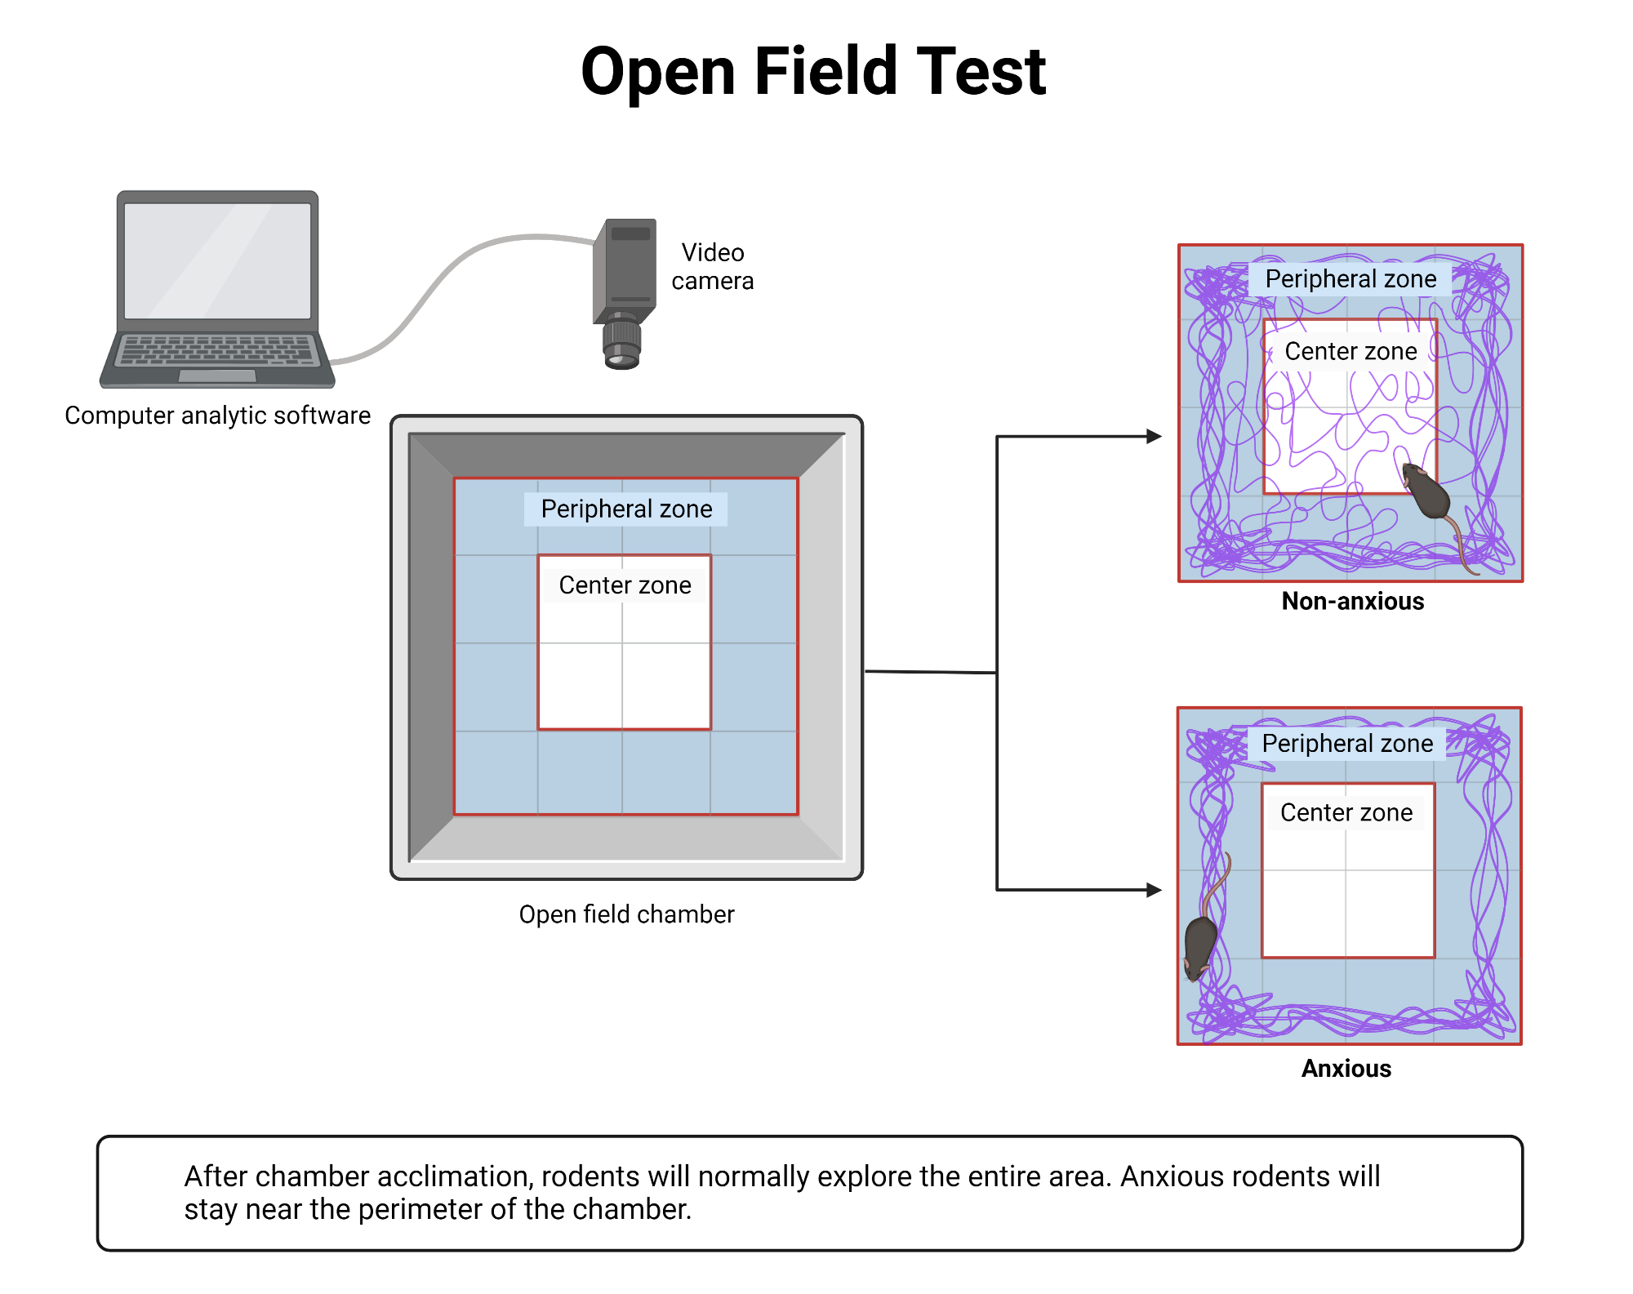
Stress
Levine, 1967
Research Question: How does early-life stress impact the adult stress response?
Methods/Task: Rat pups were either briefly handled or left undisturbed
Then their cortisol was measured in response to a stressful novel environment
Independent Variable: Early handling (handled vs. not handled)

Slide 36
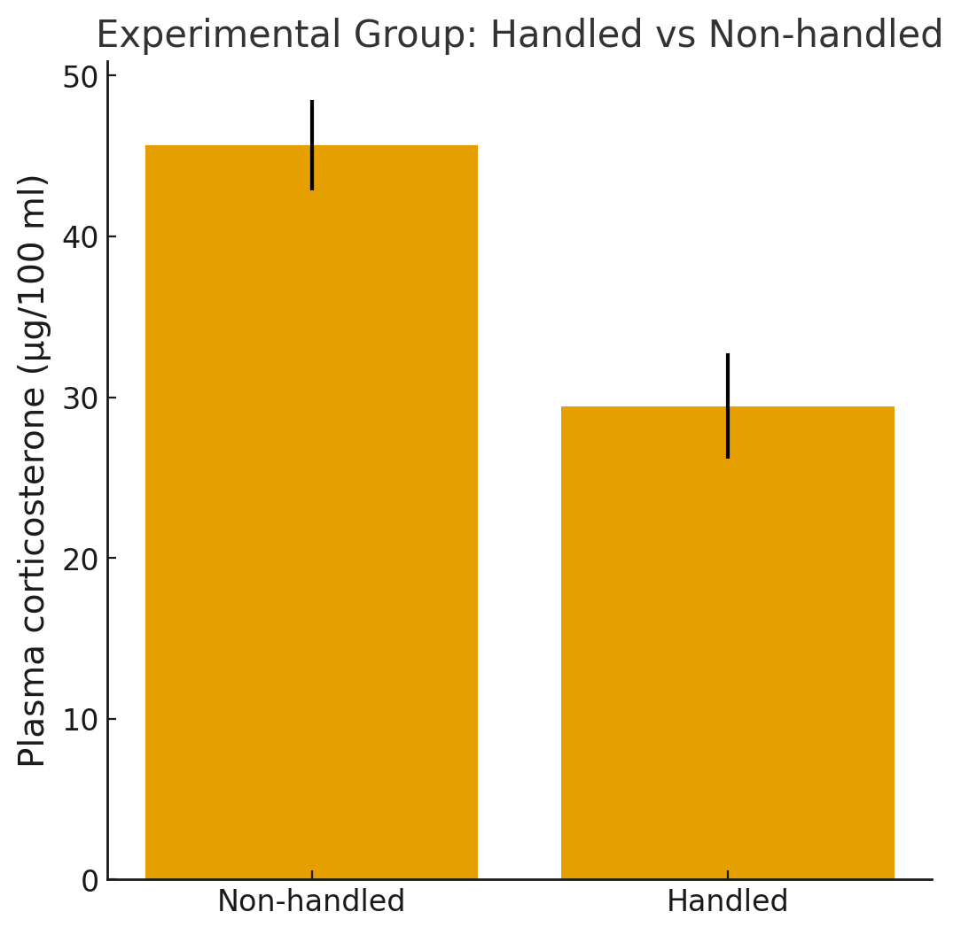
Stress
Levine, 1967
Dependent Variable: Cortisol (plasma corticosterone)
Results: Handled rats had lower cortisol levels than unhandled rats

Slide 37
Stress
Levine, 1967
Conclusion: Brief early handling produces long-term stress resilience
Liu et al., 1997: Stress resilience only when pups receive maternal licking and grooming after stress
It is early caregiving, not the stress itself, that buffers the stress response

Slide 38
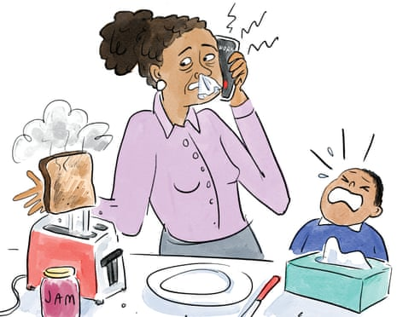
Stress
Acute Stress and the Immune System
Timeline: Minutes to hours
Hormones: Cortisol rises rapidly
Immune System: Suppressed by cortisol
Blood flow prioritized to muscles and brain rather than immune and digestive systems
Antibody production decreases
White blood cell activity reduced
Effects
Prioritizes immediate survival over fighting infection
Conserves energy for fight-or-flight response

Slide 39
Stress
Chronic Stress and the Immune System
Timeline: Weeks to years
Hormones: Cortisol chronically elevated
Does not return to baseline
Immune System: Chronic suppression by cortisol
Blood flow changes, decreased antibody production, decreased white blood cell activity
Effects
Increased infection rates
Slower wound healing
Increased inflammation and risk of autoimmune-related symptoms

Slide 40
Stress
Chronic Stress and Oxytocin
Oxytocin is released during chronic stress
It is a protective hormone that counteracts some effects of cortisol
It promotes seeking social support to help cope with stress
Social support can reduce perceived stress and physiological stress responses

Slide 41
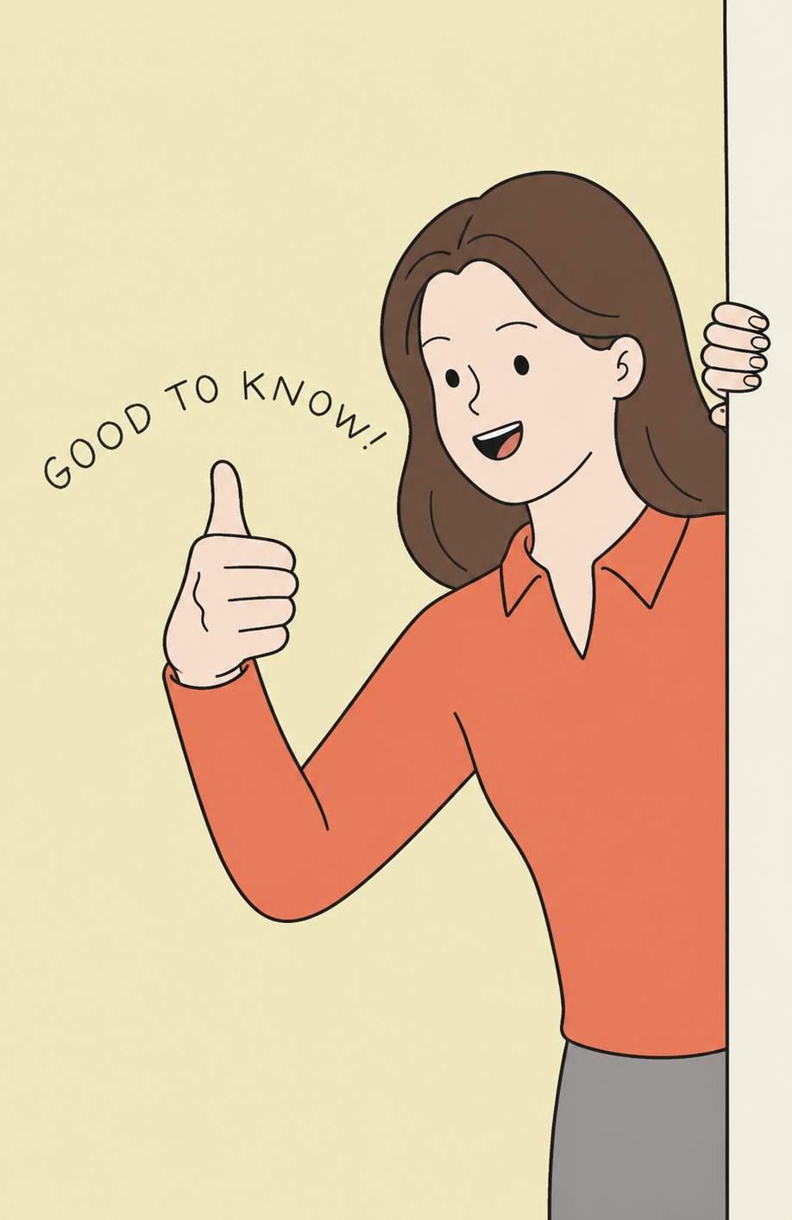
Testable Figures
Slide 13
Slide 24
All figures corresponding to the results of a study are testable material.

